Slide 1
For the Presenter
This is designed to be delivered in person
Need to get Azure Passes in advance - https://requests.microsoftazurepass.com/OneTime/Request

Slide 2
Ensuring well-governed Azure environments
Nicole.Welch@Microsoft.com
David Miller
Notes:
Today we are going to go over how you can implement effective governance at scale across all your environments

Slide 3
Agenda
Topic | Time
Logistics | 9:30am
Overview | 9:45am
Enrollment Setup, Management Groups | 10:00 – 10:30am
Challenge | 10:30 – 11:00am
Azure Policy and RBAC | 11:00 – 11:30pm
Challenge | 11:30 – 12:30pm
Lunch | 12:30 – 1:30pm
Blueprints | 1:30 – 2:00pm
Challenge | 2:00 – 2:30pm
Cost Management | 2:30 – 3:00pm
Challenge | 3:00 – 3:30pm
Closing | 3:30 – 4:00pm

Slide 4
Logistics
To emphasis concepts, you will implement solutions as teams.

Slide 5
Subscription sETUP
Subscription details will be physically handed out to each team
Follow instructions at https://github.com/nluedeman/GovernanceHackathon

Slide 6
Agenda
Topic | Time
Logistics | 9:30am
Overview | 9:45am
Enrollment Setup, Management Groups | 10:00 – 10:30am
Challenge | 10:30 – 11:00am
Azure Policy and RBAC | 11:00 – 11:30pm
Challenge | 11:30 – 12:30pm
Lunch | 12:30 – 1:30pm
Blueprints | 1:30 – 2:00pm
Challenge | 2:00 – 2:30pm
Cost Management | 2:30 – 3:00pm
Challenge | 3:00 – 3:30pm
Closing | 3:30 – 4:00pm

Slide 7
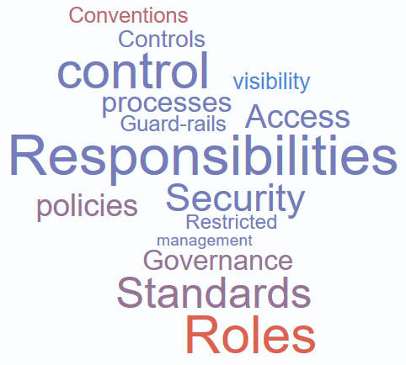
What is Governance?
Notes:
In the past was often a set of procedures and policies that developed over time. Generally service owners and application developers viewed them as roadblocks or delays

Slide 8
Why is Governance needed?
Pressure to digitally transform & innovate
Need for agility to reduce speed to market
Shift to DevOps
Cloud Sprawl -> Increased complexity in managing standard, accountability, compliance, consistent architecture & cost ->
at Scale
Notes:
https://www.youtube.com/watch?v=ZuDg9-z8uuY
Companies are adopting the cloud to be more agile and save money. There’s pressure to digitally transform and innovate so you don’t have anymore the time to focus on your own infrastructure. You want to focus on making your customers happy by providing high-quality services that are supported by your engineering teams. So, there is a natural shift to DevOps in a Cloud environment where engineers will more rapidly provision the resources necessary to support a solution.
But this agility and easy access to resources has a price tag and many companies are struggling to control this Cloud Sprawl.
We’ve seen this before in early 2000 with the introduction of virtualization and virtualization sprawl. How did the industry react to that sprawl? <continues in next slide>

Slide 9



Governance Tools for the cloud
Native platform capabilities to ensure compliant use of cloud resources
Enrollment
Management Group
RBAC
Policy
Blueprints
Cost Management
Define organizational hierarchy
Fine-grained access management of Azure resources
Real-time enforcement, compliance assessment and remediation
Deploy and update cloud environments in a repeatable manner using composable artifacts
Monitor cloud spend and optimize resources
Hierarchy
Control
Control
Environment
Consumption
https://docs.microsoft.com/en-us/azure/cost-management/
Notes:
The capabilities that we have within the portfolio to deliver that level of control is what you see in the slide right now. These are all native platform capabilities, in other words, nothing here is a different product you need to acquire or deploy into your cloud environment. The moment you create your first subscription, these capabilities are there for you and are completely free.
Policy – this is where you will define what can or cannot be deployed in the Cloud. It will constantly scan your subscriptions and resources to make sure everything is within the corporate rules.
Blueprints – helps you setup your cloud environment that is properly governed and deployed in a repeatable manner. Subscriptions are provided to application teams or departments as they get onboarded. And the goal here is when they get onboarded to a governed subscription by Blueprints, the amount of time that they need to take from inception to production is going to dramatically decrease.
Resource graph – this is a big data technology where we bring all your resources configuration across the entire cloud environment and offer to you through a structure query language the ability to explore your environment very quickly allowing visibility at scale across your entire environment.
Management group - If your organization has many subscriptions, you may need a way to efficiently manage access, policies, and compliance for those subscriptions. This can be done through Management Group.
Cost – the notion of cost will be attached to all of these elements, but we won’t cover that in this module. You can refer to the link shown in the slide for more information.

Slide 10

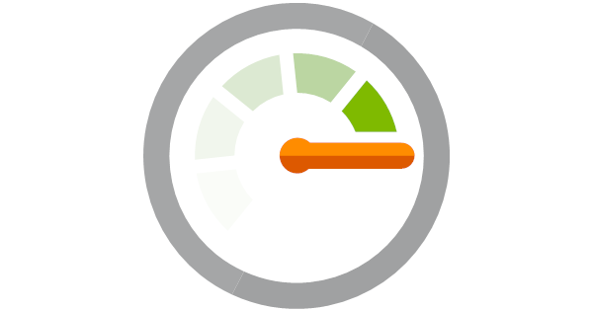

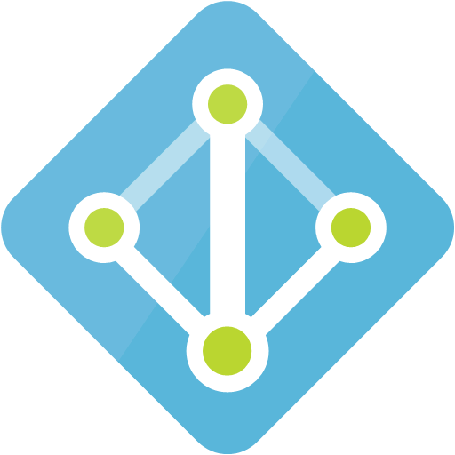

Other Tools
Other players in the governance space
Azure Security Center
Azure Log Analytics
Azure Monitor
Azure DevOps
AAD Premium
Free and Standard Tiers
Prevent, Detect, and Defend Azure Resources
VM JIT access
Pay per GB of Data
Detailed monitoring of Azure and Applications
Free
Allows for basic monitoring and alerting on most resources
Paid offering
Infrastructure as code
Reproduceable, self-documenting deployments
Paid add-on
P1 and P2
Allows MFA, Conditional Access, Privileged Identity Management

Slide 11
Other Tools
Other players in the governance space
Tagging
Naming Conventions
Name and Value Pair to link metadata to resources
Not all ARM resources support tags, but the most common do
Helps organize resources for billing or management
Allows you to link resources across resource groups and subscriptions
Enable scripting and automation by having standard conventions.
The choice of a name for any resource in Microsoft Azure is important because:
It is difficult to change a name later
Resources and resources groups can not be renamed
Names must meet the requirements of their specific resource type

Slide 12

Governance Tools for the cloud
Native platform capabilities to ensure compliant use of cloud resources
Enrollment
Management Group
RBAC
Policy
Blueprints
Cost Management
Define organizational hierarchy
Fine-grained access management of Azure resources
Real-time enforcement, compliance assessment and remediation
Deploy and update cloud environments in a repeatable manner using composable artifacts
Monitor cloud spend and optimize resources
Hierarchy
Control
Control
Environment
Consumption
https://docs.microsoft.com/en-us/azure/cost-management/
Notes:
The capabilities that we have within the portfolio to deliver that level of control is what you see in the slide right now. These are all native platform capabilities, in other words, nothing here is a different product you need to acquire or deploy into your cloud environment. The moment you create your first subscription, these capabilities are there for you and are completely free.
Policy – this is where you will define what can or cannot be deployed in the Cloud. It will constantly scan your subscriptions and resources to make sure everything is within the corporate rules.
Blueprints – helps you setup your cloud environment that is properly governed and deployed in a repeatable manner. Subscriptions are provided to application teams or departments as they get onboarded. And the goal here is when they get onboarded to a governed subscription by Blueprints, the amount of time that they need to take from inception to production is going to dramatically decrease.
Resource graph – this is a big data technology where we bring all your resources configuration across the entire cloud environment and offer to you through a structure query language the ability to explore your environment very quickly allowing visibility at scale across your entire environment.
Management group - If your organization has many subscriptions, you may need a way to efficiently manage access, policies, and compliance for those subscriptions. This can be done through Management Group.
Cost – the notion of cost will be attached to all of these elements, but we won’t cover that in this module. You can refer to the link shown in the slide for more information.

Slide 13
Starting at the top…..
Enterprise Agreement
Invoice Level
EA Admins can create department + account owners
Account C
Subscription 5
Account A
Account B
Subscription 1
Subscription 2
Subscription 3
Enrollment
Department A
Resource Group 1
Resource Group 2
Optional layer in the hierarchy
Can create Account Owners
Ability to create subscriptions
Are default owners of subscriptions
Charges incurred within
RBAC and Billing Unit
Charges incurred within
Resources must be in an RG
Group resources based on lifecycle

Slide 14
Making Choices….
Multiple Enrollments versus Subscriptions
 | Multiple Subscriptions | Enrollments
Separate Invoice |  | ✓
Able to view charges at this level | ✓ | ✓
Can use unique AAD Tenant | ✓ | ✓
Can view charges in EA Portal | ✓ | ✓
Can share an ExpressRoute | ✓ | ✓
Simple to Administer | ✓

Slide 15
Making Choices….
Resource Groups versus Subscriptions
 | Resource Groups | Subscriptions
RBAC supported | ✓ | ✓
Easy to view Billing | ✓ (in Azure portal only) | ✓ (in EA and Azure portal)
Resource can be shared across | ✓ (natively) | Requires additional configuration and only some resources are supported
Azure Policy supported | ✓ | ✓
Best for Sandbox |  | ✓
Best for restricting access in a common environment (i.e. PROD) | ✓
Simpler to Administer | ✓ | Multiple subscriptions create administrative overhead
Can share a single ExpressRoute | ✓ | ✓

Slide 16
Department/Account Setup Options
Functional
Business Division
Geographic
Functional
Enterprise
Enterprise
Enterprise
Enterprise
Departments
Finance
Marketing
Auto
Aerospace
North America
Europe
Accounts
Proj New Plane
Ted Bear
Grace Ma
Joe Smith
Jane Doe
Proj New Car
Subscriptions
Project 1 Dev
Project 1 Test
Production Web Sites
Application 1
Application 2
Application 3
Project 1
Project 2
Project 3

Slide 17
Begin with the EA Portal….
Enterprise Admin
Can add other Enterprise and Department Administrators, add Departments, add or associate Accounts to the Enrollment, can view usage and charges data across all Accounts and Subscriptions, can view the monetary commitment balance associated to the Enrollment. There is no limit to the number of Enterprise Administrators on an Enrollment.
Department Admin
Can edit their department name and cost center, manage department admins, add accounts to the enrollment and their departments, remove accounts from their departments and view Department charges if enabled by the Enterprise Admin.
Account Owner
Can add subscriptions to the account, update the Service Administrator and Co-Administrator for an individual subscription, view usage data for their Account, and view Account charges if enabled by the Enterprise Administrator. The Account Owner will not have visibility of the monetary commitment balance unless they also have Enterprise Administrator rights.
These are powerful identities!
Restrict standing access, i.e. check in/out or service IDs
Audit usage
Create stand-alone identities when possible, i.e. do not use the same ID email, etc.
Secure them with MFA

Slide 18
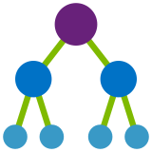
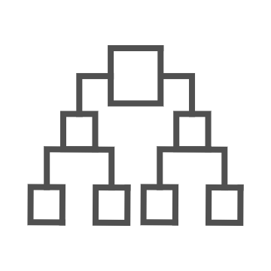
Azure Management Groups
Make environment management easier by grouping subscriptions together
Create a hierarchy of management groups that fit your organization
Apply governance controls with policies and access controls along with other Azure services
Grouping subscriptions into logical groups allow for new organization models
Inheritance allows for single assignment of controls that apply to all subscriptions
Aggregated views
Create a flexible hierarchy that can be updated quickly
Hierarchy doesn’t need to model the organizations billing hierarchy
Can easily scale depending on the organizational needs
Azure Resource Manager (ARM) objects that allow integrations with other Azure services
Azure services:
Azure Policy
RBAC
Azure Cost Management
Azure Blueprints
Azure Security Center
Notes:
Let’s discuss further Azure Blueprints.
In terms of the best practices of setting up governance in your environment structuring your hierarchy and organizing your resources is the first critical step.
Everything you do, from setting RBAC rules to resources, to Azure Policy to Blueprint, all of these things hang on to the hierarchy and the first benefit of Mgmt Grp is inheritance. So whatever you apply at the top will be inherited down to the lowest level of your structure.
Let’s say a SOC team applies a set of security controls at the top to protect the entire environment. The problem today is that subscription owners can remove any control at the subscription level and many times you make the application teams owners of the subscription just because they need that flexibility. With Mgmt Group that option is now removed.

Slide 19
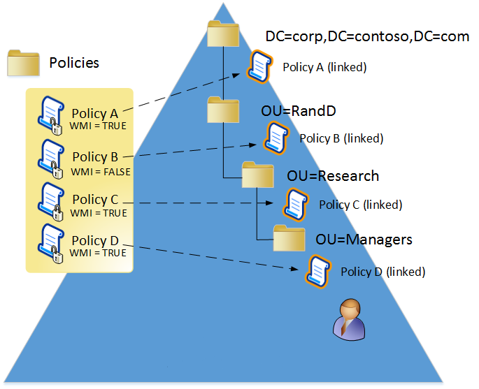
For comparison, look at Windows Active Directory
In the on-premises world, we implement Windows standards with Active Directory
Organizational Units (OU) – Logical container to group objects
Group Policy (GPO) – a collection of settings, applied to OUs
Objects – users, computers, etc. stored in OUs

Slide 20

Management Groups for Enterprises
Organizational alignment for your Azure subscriptions through custom hierarchies and grouping
Enables targeting of policies across all subscriptions and inheritance down the hierarchies
Enables compliance by organizations (business/teams)
Notes:
Azure Policy: a powerful governance platform that enables the largest enterprises to govern their cloud environment at scale across all subscriptions declaratively
This helps enterprises to:
Enforce standards and guardrails
Meet regulatory compliance and audit requirements
Control costs
Maintain security and performance consistency
Impose enterprise wide design principles
Policy-based management
Add policies to your resources
Turn on built-in policies, or build your own custom policies to enable security and management at scale for Azure resources. Restrict deployment options for your organization to specific datacenters, or enable the creation of specific resources types only. Establish tagging metadata to help drive accountability, compliance, and much more.
Choose how to build your policies
Construct policies in the Azure portal with full IntelliSense support or any JSON editor, and import policies using Bash, PowerShell, or API.
Apply policies at any scale
Apply policy over your Azure resources at a scale of your choosing, from a single subscription to a management group with control across your entire organization.
Monitor compliance
Choose to either enforce policies, or audit policy compliance against best practices. View policy compliance for individual policies, or aggregate multiple policies together into initiatives and oversee compliance for the whole initiative. See how compliance to policies is trending over time.

Slide 21
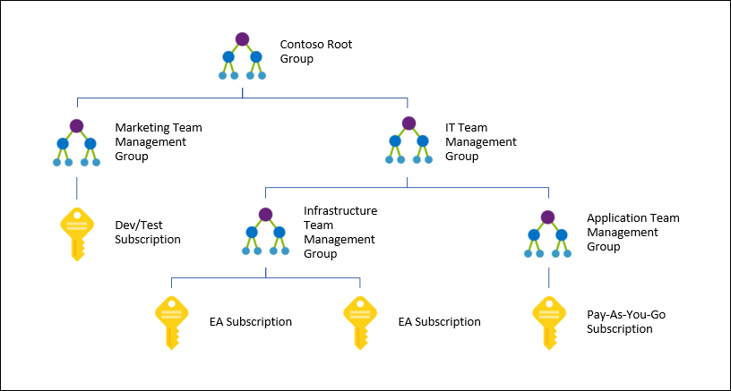
Management Groups (MG)
Subscriptions automatically inherit the conditions applied to the management group
Policy - Policy is inherited and cannot be altered by the resource or subscription owner allowing for improved governance
RBAC - Create one RBAC assignment on the management group, all child subscriptions will inherit that access
*Custom RBAC roles currently are NOT supported on MGs but soon be available soon after General Availability (GA)

Slide 22

Use Management Groups to organize subscriptions
Create a custom management hierarchy to fit your organization
Enables RBAC, policies for tagging, cost analysis and budgets at any scope
Shared with Policy, Security Center, Privileged Identity Management services

Slide 23
Management Group Limits
10,000 management groups can be supported in a single directory.
A management group tree can support up to six levels of depth.
Each management group and subscription can only support one parent.
Each management group can have multiple children.
All subscriptions and management groups are contained within a single hierarchy in each directory.

Slide 24
Root Management Group Idiosyncrasies
The root management group can't be moved
The Directory Administrator needs to elevate themselves to be the owner of this root group initially. Once the administrator is the owner of the group, they can assign any RBAC role to other directory users or groups to manage the hierarchy.
All Azure customers can see the root management group, but not all customers have access to manage that root management group.
No one is given default access to the root management group.
All subscriptions and management groups fold up to the one root management group within the directory.
New subscriptions are automatically defaulted to the root management group when created.

Slide 25
Demo

Slide 26

Management Groups -
Azure Governance Lab/HandsOn/Hack
Create the following hierarchy and place your subscription Central IT MG.
Contoso
Central IT
Biz Apps
Subscription

Slide 27
Agenda
Topic | Time
Logistics | 9:30am
Overview | 9:45am
Enrollment Setup, Management Groups | 10:00 – 10:30am
Challenge | 10:30 – 11:00am
Azure Policy and RBAC | 11:00 – 11:30pm
Challenge | 11:30 – 12:30pm
Lunch | 12:30 – 1:30pm
Blueprints | 1:30 – 2:00pm
Challenge | 2:00 – 2:30pm
Cost Management | 2:30 – 3:00pm
Challenge | 3:00 – 3:30pm
Closing | 3:30 – 4:00pm

Slide 28
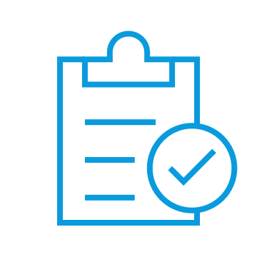
Governance Tools for the cloud
Native platform capabilities to ensure compliant use of cloud resources
Enrollment
Management Group
RBAC
Policy
Blueprints
Cost Management
Define organizational hierarchy
Fine-grained access management of Azure resources
Real-time enforcement, compliance assessment and remediation
Deploy and update cloud environments in a repeatable manner using composable artifacts
Monitor cloud spend and optimize resources
Hierarchy
Control
Control
Environment
Consumption
https://docs.microsoft.com/en-us/azure/cost-management/
Notes:
The capabilities that we have within the portfolio to deliver that level of control is what you see in the slide right now. These are all native platform capabilities, in other words, nothing here is a different product you need to acquire or deploy into your cloud environment. The moment you create your first subscription, these capabilities are there for you and are completely free.
Policy – this is where you will define what can or cannot be deployed in the Cloud. It will constantly scan your subscriptions and resources to make sure everything is within the corporate rules.
Blueprints – helps you setup your cloud environment that is properly governed and deployed in a repeatable manner. Subscriptions are provided to application teams or departments as they get onboarded. And the goal here is when they get onboarded to a governed subscription by Blueprints, the amount of time that they need to take from inception to production is going to dramatically decrease.
Resource graph – this is a big data technology where we bring all your resources configuration across the entire cloud environment and offer to you through a structure query language the ability to explore your environment very quickly allowing visibility at scale across your entire environment.
Management group - If your organization has many subscriptions, you may need a way to efficiently manage access, policies, and compliance for those subscriptions. This can be done through Management Group.
Cost – the notion of cost will be attached to all of these elements, but we won’t cover that in this module. You can refer to the link shown in the slide for more information.

Slide 29
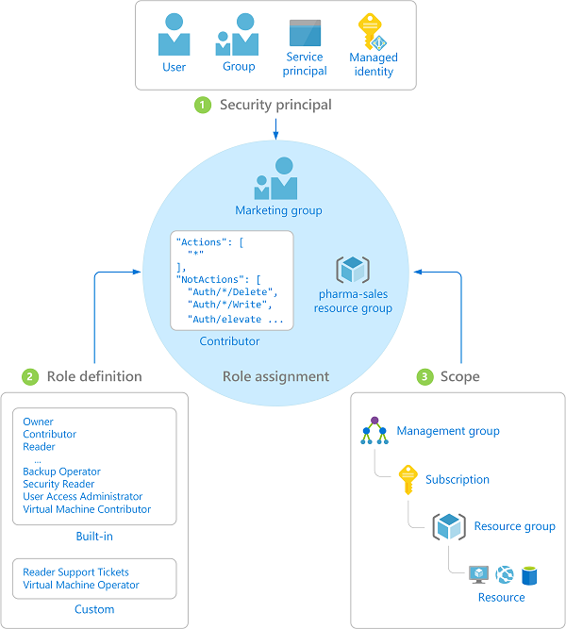
Azure Role-Based Access Control (RBAC)
Fine-grained access control to Azure “control plane”
Grant access by assigning Security Principal a Role at a Scope
Security Principal: User, group, or service principal
Role: Built-in or custom role
Scope: MG, Subscription, resource group, or resource
Assignments are inherited down the resource hierarchy
https://aka.ms/azureiam
Notes:
Using RBAC, you can segregate duties within your team and grant only the amount of access to users that they need to perform their jobs. Instead of giving everybody unrestricted permissions in your Azure subscription or resources, you can allow only certain actions at a particular scope.
<CLICK1>
Security principal
A security principal is an object that represents a user, group, service principal, or managed identity that is requesting access to Azure resources.
- Service principal - A security identity used by applications or services to access specific Azure resources. You can think of it as a user identity (username and password or certificate) for an application.
Managed identity - An identity in Azure Active Directory that is automatically managed by Azure. You typically use managed identities when developing cloud applications to manage the credentials for authenticating to Azure services.
<CLICK2>
Role definition
A role definition is a collection of permissions. It's sometimes just called a role. A role definition lists the operations that can be performed, such as read, write, and delete. Roles can be high-level, like owner, or specific, like virtual machine reader. You can create custom roles if none of the existing built-in roles don't meet the specific needs of your organization.
<CLICK3>
Scope
Scope is the boundary that the access applies to. When you assign a role, you can further limit the actions allowed by defining a scope. This is helpful if you want to make someone a Website Contributor, but only for one resource group.

Slide 30
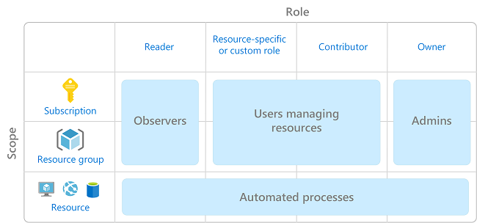
Azure Role-based Access (RBAC)
How to put it to work for you
Grant users the least privilege to get their work done
Apply rights as globally as possible (leverage management groups)
Use RBAC (and resource groups) to allow separate teams to work within a single subscriptions
Automatically apply to linked services like Azure Security Center, etc.
Leverage Microsoft-created roles. 100% custom roles must be maintained by YOU
Be mindful of service dependencies (i.e. VM creation requires you to create compute, disk, and NIC resources)

Slide 31
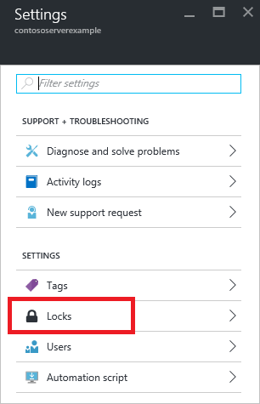
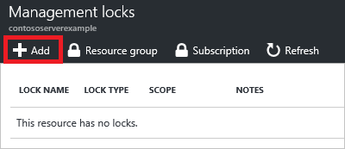
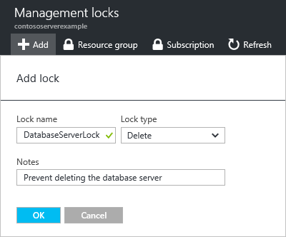
Resource LockS
Lock a Subscription, resource group, or resource to prevent accidental deletion or modification.
CanNotDelete / ReadOnly
Locks apply only to management operations, not to resources functions
Caution: ReadOnly can cause unexpected results
Lock on a storage account prevents all users from listing keys
Lock on App Service prevents Visual Studio Server Explorer from displaying files for the resource because that interaction requires write access
Soft deletes
Notes:
https://docs.microsoft.com/en-us/azure/azure-resource-manager/resource-group-lock-resources
How locks are applied
When you apply a lock at a parent scope, all resources within that scope inherit the same lock. Even resources you add later inherit the lock from the parent. The most restrictive lock in the inheritance takes precedence.
Unlike role-based access control, you use management locks to apply a restriction across all users and roles. To learn about setting permissions for users and roles, see Azure Role-based Access Control.
Resource Manager locks apply only to operations that happen in the management plane, which consists of operations sent to https://management.azure.com. The locks do not restrict how resources perform their own functions. Resource changes are restricted, but resource operations are not restricted. For example, a ReadOnly lock on a SQL Database prevents you from deleting or modifying the database, but it does not prevent you from creating, updating, or deleting data in the database. Data transactions are permitted because those operations are not sent to https://management.azure.com.
Applying ReadOnly can lead to unexpected results because some operations that seem like read operations actually require additional actions. For example, placing a ReadOnly lock on a storage account prevents all users from listing the keys. The list keys operation is handled through a POST request because the returned keys are available for write operations. For another example, placing a ReadOnly lock on an App Service resource prevents Visual Studio Server Explorer from displaying files for the resource because that interaction requires write access.

Slide 32
Demo

Slide 33
Governance Tools for the cloud
Native platform capabilities to ensure compliant use of cloud resources
Enrollment
Management Group
RBAC
Policy
Blueprints
Cost Management
Define organizational hierarchy
Fine-grained access management of Azure resources
Real-time enforcement, compliance assessment and remediation
Deploy and update cloud environments in a repeatable manner using composable artifacts
Monitor cloud spend and optimize resources
Hierarchy
Control
Control
Environment
Consumption
https://docs.microsoft.com/en-us/azure/cost-management/
Notes:
The capabilities that we have within the portfolio to deliver that level of control is what you see in the slide right now. These are all native platform capabilities, in other words, nothing here is a different product you need to acquire or deploy into your cloud environment. The moment you create your first subscription, these capabilities are there for you and are completely free.
Policy – this is where you will define what can or cannot be deployed in the Cloud. It will constantly scan your subscriptions and resources to make sure everything is within the corporate rules.
Blueprints – helps you setup your cloud environment that is properly governed and deployed in a repeatable manner. Subscriptions are provided to application teams or departments as they get onboarded. And the goal here is when they get onboarded to a governed subscription by Blueprints, the amount of time that they need to take from inception to production is going to dramatically decrease.
Resource graph – this is a big data technology where we bring all your resources configuration across the entire cloud environment and offer to you through a structure query language the ability to explore your environment very quickly allowing visibility at scale across your entire environment.
Management group - If your organization has many subscriptions, you may need a way to efficiently manage access, policies, and compliance for those subscriptions. This can be done through Management Group.
Cost – the notion of cost will be attached to all of these elements, but we won’t cover that in this module. You can refer to the link shown in the slide for more information.

Slide 34

Azure Policy
Turn on built-in policies or build custom ones for all resource types
Apply policies to a Management Group with control across your entire organization
Real time remediation
Real-time policy evaluation and enforcement
Apply multiple policies and & aggregate policy states with policy initiative
Remediation on existing resources (NEW)
Periodic & on-demand compliance evaluation
Exclusion Scope
VM In-Guest Policy (NEW)
Enforcement & Compliance
Apply policies at scale
Remediation
Notes:
Policy is the backbone of enforcement and compliance in Azure. Compliance is an evolving landscape that you will always need to evaluate and adjust according to the needs of the present time. You also need to plan carefully your policies so you don’t disrupt other unities that require a more flexible policy than the one you defined.
Through policies, you can control the types of resources that can be provisioned. Or, you can restrict the locations in which the resources can be provisioned. Unlike RBAC, policy is a default allow and explicit deny system.
Azure Policy is a service that you use to create, assign and, manage policy definitions. Policy definitions enforce different rules and actions over your resources, so those resources stay compliant with your corporate standards and service level agreements.
Policy focuses on resource properties during deployment and for already existing resources.
Azure Policy runs an evaluation of your resources, scanning for those not compliant with the policy definitions you have.
VM guest policy: this is a new feature that extends the policy capability to the resources running inside your VMs

Slide 35
How does it work?
Policies enforce different rules and effects over your resources, so those resources stay compliant with your corporate standards and service level agreements
Policies are DEFINED (e.g. what VM SKUs are allowed) and then ASSIGNED to a scope (e.g. a subscription)
Initiatives are a collection of policy definitions designed to achieve a single goal

Slide 36
Azure Policy
1
Ensure compliance
2
Empower DevOps
Common use cases
3
Manage costs
Limit allowed Azure VM Images
Limit allowed Azure regions/data centers
Limit allowed resource types
Enforce tags and default values
Audit missing Endpoint Protection in Security Center
Audit diagnostic setting
Audit accounts with owner permissions who are not MFA enabled on a subscription
Audit HTTPS only access for a Web Application
Audit that Windows VMs have a minimum password age of 1 day
Enable Azure Monitor for VMs
Audit ISO 27001:2013 controls and deploy specific VM Extensions to support audit requirements

Slide 37
Order of Evaluation
Policy creates a list of all policy definitions assigned that apply by scope (minus exclusions) to the resource
The definitions are then evaluated in the following order:
Append
Deny
Audit
DeployIfNotExists
AuditIfNotExists

Slide 38
Enforce VM SKUs of basic A series
"properties": {
"displayName": "Allowed VM Skus",
"description": "This policy enables you to specify a set of virtual machine SKUs that your
organization can deploy.“
},
"policyRule": {
"if": {
"allOf": [
{
"field": "type",
"equals": "Microsoft.Compute/virtualMachines“
},
{
"not": {
"field":"Microsoft.Compute/virtualMachines/sku.name",
"in": ["Basic_A0”,”Basic_A1”,”Basic_A2”,”Basic_A3”,”Basic_A4”]
}
}
]
},
"then": {
"effect": "Deny“
}
}

Slide 39
Commonly Implemented Policies
Blob storage encryption should be enabled
File storage encryption should be enabled
SQL TDE should be enabled
SQL threat detection should be enabled
VMs should have the antimalware extension enabled
VMs should only use managed disks
Storage accounts should not be open to all public networks
(Express Route) Deny all public IP addresses

Slide 40
Azure Policy versus RBAC
Let’s review
RBAC focuses on user actions at a specific scope (resource, subscription, etc.)
Policy focuses on resource properties (what is allowed, where, with what attributes, etc.)

Slide 41
Demo

Slide 42
RBAC and Policy-
Azure Governance Lab/HandsOn/Hack
Using Azure Policy, identify which VMs are NOT using managed disk.
Using Azure Policy, restrict resource deployment to CONUS regions
Using RBAC, assign the user “Tester” contributor access only within resource group “Testing”. “Tester” should have NO access outside this resource group.

Slide 43
Agenda
Topic | Time
Logistics | 9:30am
Overview | 9:45am
Enrollment Setup, Management Groups | 10:00 – 10:30am
Challenge | 10:30 – 11:00am
Azure Policy and RBAC | 11:00 – 11:30pm
Challenge | 11:30 – 12:30pm
Lunch | 12:30 – 1:30pm
Blueprints | 1:30 – 2:00pm
Challenge | 2:00 – 2:30pm
Cost Management | 2:30 – 3:00pm
Challenge | 3:00 – 3:30pm
Closing | 3:30 – 4:00pm

Slide 44

Governance Tools for the cloud ,
Native platform capabilities to ensure compliant use of cloud resources
Management Group
RBAC
Policy
Blueprints
Cost Management
Define organizational hierarchy
Fine-grained access management of Azure resources
Real-time enforcement, compliance assessment and remediation
Deploy and update cloud environments in a repeatable manner using composable artifacts
Monitor cloud spend and optimize resources
Hierarchy
Control
Control
Environment
Consumption
https://docs.microsoft.com/en-us/azure/cost-management/
Notes:
The capabilities that we have within the portfolio to deliver that level of control is what you see in the slide right now. These are all native platform capabilities, in other words, nothing here is a different product you need to acquire or deploy into your cloud environment. The moment you create your first subscription, these capabilities are there for you and are completely free.
Policy – this is where you will define what can or cannot be deployed in the Cloud. It will constantly scan your subscriptions and resources to make sure everything is within the corporate rules.
Blueprints – helps you setup your cloud environment that is properly governed and deployed in a repeatable manner. Subscriptions are provided to application teams or departments as they get onboarded. And the goal here is when they get onboarded to a governed subscription by Blueprints, the amount of time that they need to take from inception to production is going to dramatically decrease.
Resource graph – this is a big data technology where we bring all your resources configuration across the entire cloud environment and offer to you through a structure query language the ability to explore your environment very quickly allowing visibility at scale across your entire environment.
Management group - If your organization has many subscriptions, you may need a way to efficiently manage access, policies, and compliance for those subscriptions. This can be done through Management Group.
Cost – the notion of cost will be attached to all of these elements, but we won’t cover that in this module. You can refer to the link shown in the slide for more information.

Slide 45
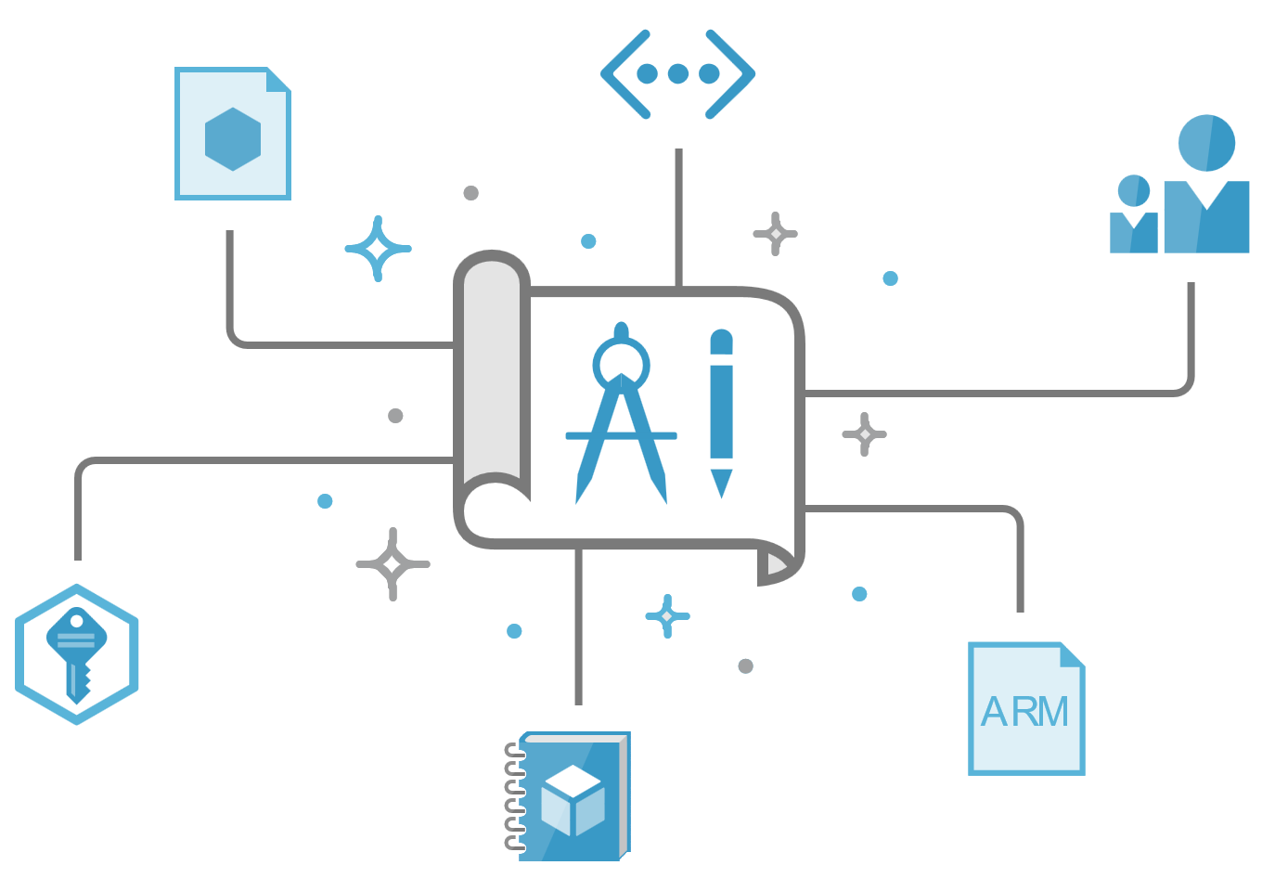

Azure Blueprints solution
automated, easy-to-deploy solution to help setup governed Azure Subscriptions
Compose
Orchestrate
Protect
Empower
Let app teams use Azure in a self-service manner while ensuring organizational standards
Compose, deploy and update cloud environments in a repeatable manner
Orchestrate deployment of Resource Templates, Policies, and RBAC
Lock down foundational infrastructure that are shared across subscriptions
Notes:
It’s a tracked entity.

Slide 46



Azure Blueprints
deploy and update cloud environments in a repeatable manner using composable artifacts
Role-based access controls
Policy Definitions
Policy Definitions
Subscription A
ARM Templates
ARM Templates
Azure Blueprints
Subscription B
Subscription C
…
compose
manage
scale

Slide 47
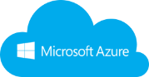



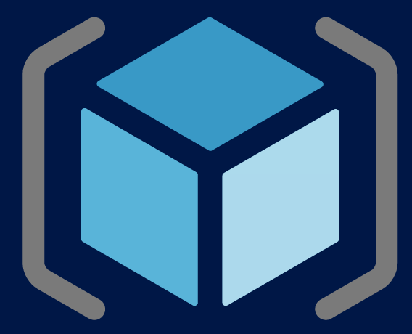
How it works
1
Contoso Blueprint
Creates a Blueprint
Cloud Engineer
Cloud Engineer
2
Policies
Adds artifacts (azure resources) to be used
Networking
4
Apply Blueprint to Scope
(MG, Sub)
RBAC
3
Identifies artifacts to be instantiated by default
Functions\Runbooks
Curated Marketplace
Other Templates
Deployed foundational artifact

Slide 48
Demo

Slide 49
Blueprints
Azure Governance Lab/HandsOn/Hack
Apply the NIST blueprint to your subscription

Slide 50
Agenda
Topic | Time
Logistics | 9:30am
Overview | 9:45am
Enrollment Setup, Management Groups | 10:00 – 10:30am
Challenge | 10:30 – 11:00am
Azure Policy and RBAC | 11:00 – 11:30pm
Challenge | 11:30 – 12:30pm
Lunch | 12:30 – 1:30pm
Blueprints | 1:30 – 2:00pm
Challenge | 2:00 – 2:30pm
Cost Management | 2:30 – 3:00pm
Challenge | 3:00 – 3:30pm
Closing | 3:30 – 4:00pm

Slide 51
Governance Tools for the cloud
Native platform capabilities to ensure compliant use of cloud resources
Enrollment
Management Group
RBAC
Policy
Blueprints
Cost Management
Define organizational hierarchy
Fine-grained access management of Azure resources
Real-time enforcement, compliance assessment and remediation
Deploy and update cloud environments in a repeatable manner using composable artifacts
Monitor cloud spend and optimize resources
Hierarchy
Control
Control
Environment
Consumption
https://docs.microsoft.com/en-us/azure/cost-management/
Notes:
The capabilities that we have within the portfolio to deliver that level of control is what you see in the slide right now. These are all native platform capabilities, in other words, nothing here is a different product you need to acquire or deploy into your cloud environment. The moment you create your first subscription, these capabilities are there for you and are completely free.
Policy – this is where you will define what can or cannot be deployed in the Cloud. It will constantly scan your subscriptions and resources to make sure everything is within the corporate rules.
Blueprints – helps you setup your cloud environment that is properly governed and deployed in a repeatable manner. Subscriptions are provided to application teams or departments as they get onboarded. And the goal here is when they get onboarded to a governed subscription by Blueprints, the amount of time that they need to take from inception to production is going to dramatically decrease.
Resource graph – this is a big data technology where we bring all your resources configuration across the entire cloud environment and offer to you through a structure query language the ability to explore your environment very quickly allowing visibility at scale across your entire environment.
Management group - If your organization has many subscriptions, you may need a way to efficiently manage access, policies, and compliance for those subscriptions. This can be done through Management Group.
Cost – the notion of cost will be attached to all of these elements, but we won’t cover that in this module. You can refer to the link shown in the slide for more information.

Slide 52

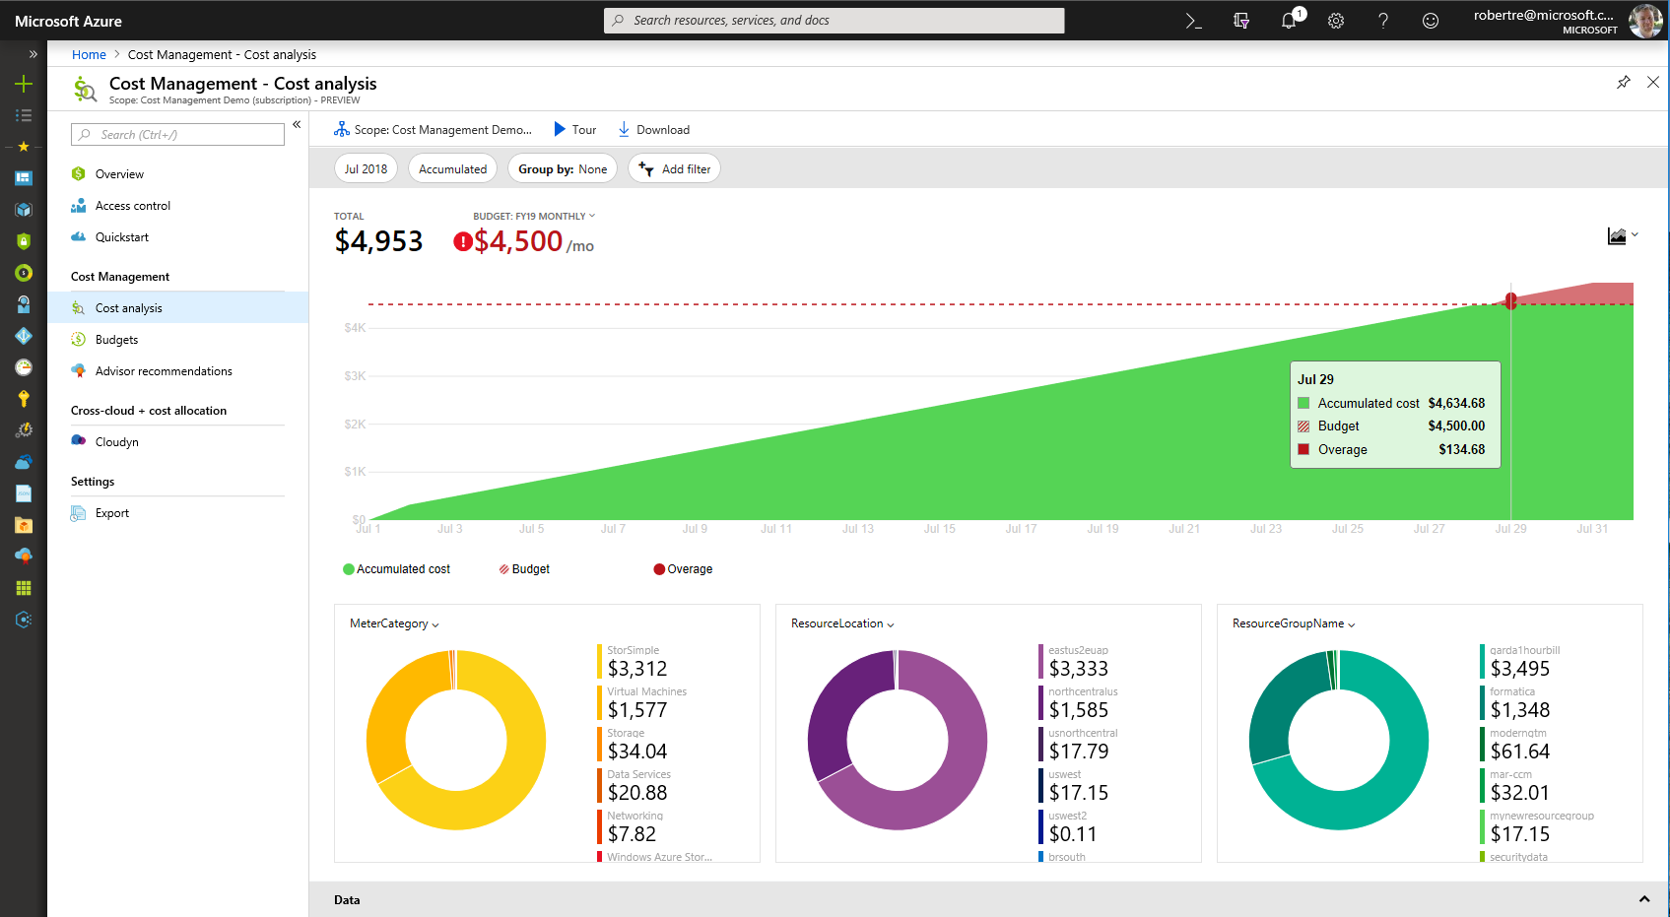
Azure Cost Management Built into Azure
On by default
Better experience for more users
Richer analysis and budget alerting
Integrated with Azure Advisor
Reduced data latency by up to 80%
Free to manage Azure costs

Slide 53
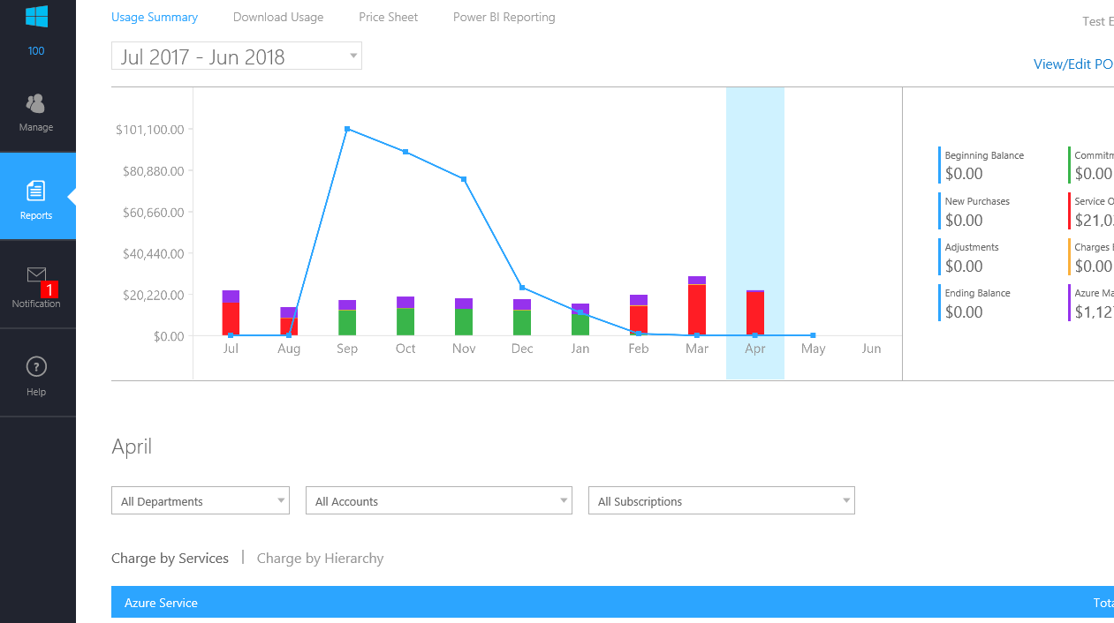
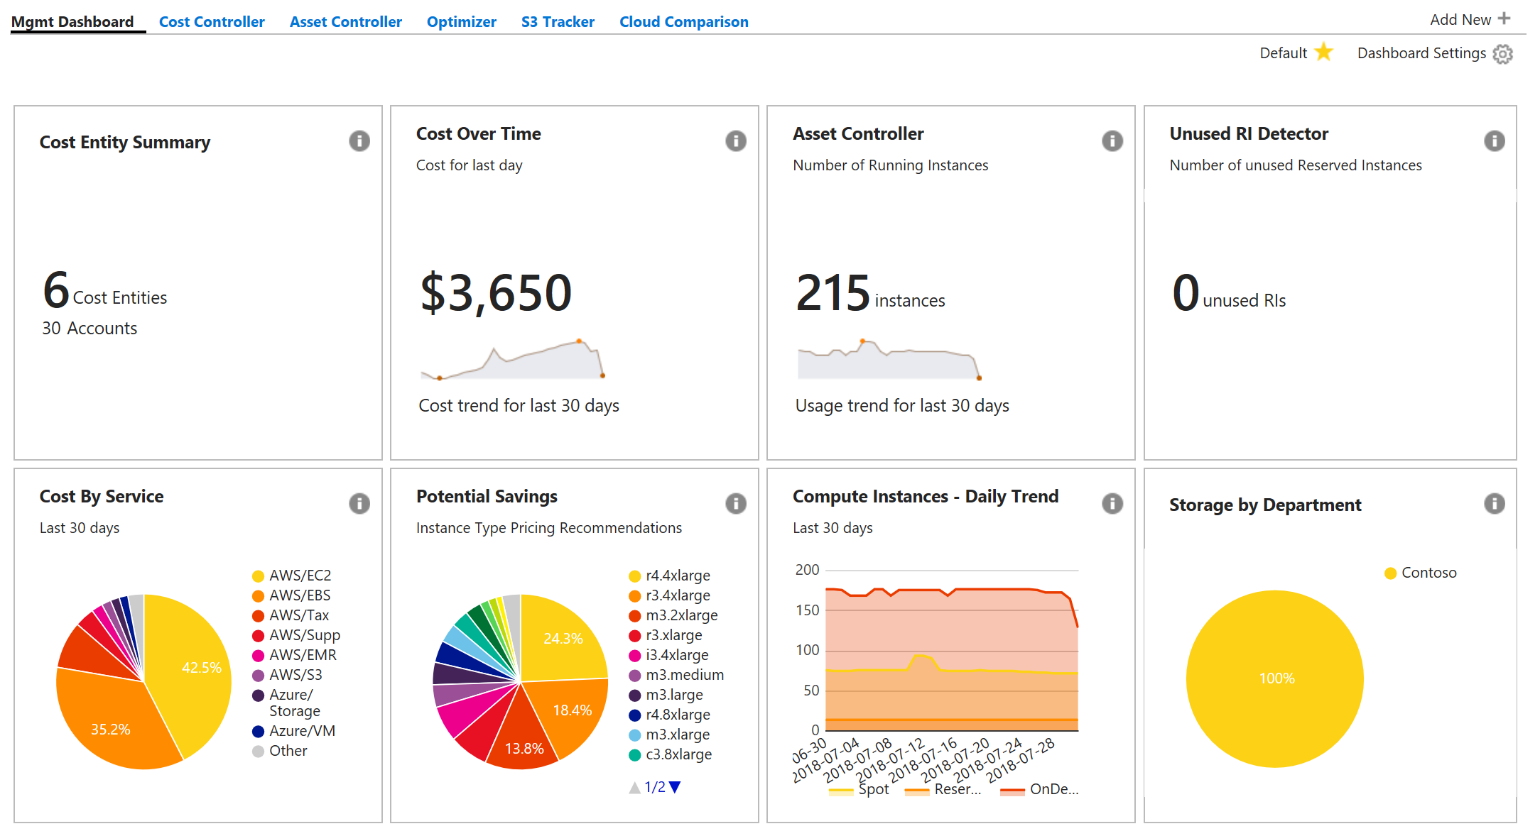
together in Azure Portal!
Enterprise Portal
Azure Cost Management
Cost Management By Cloudyn
Notes:
Reducing # of portals…and we will cover details in upcoming slides..

Slide 54
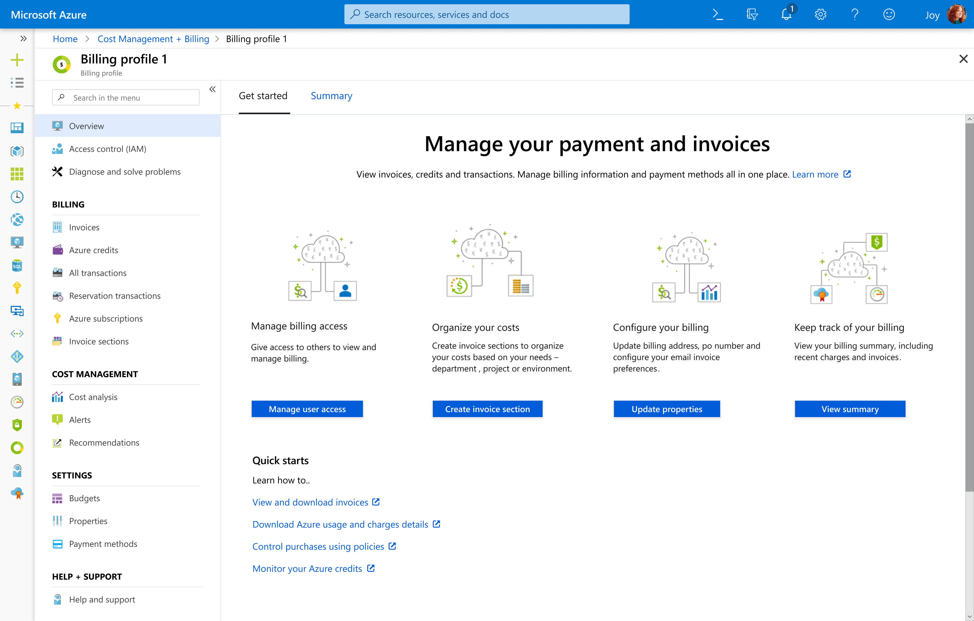
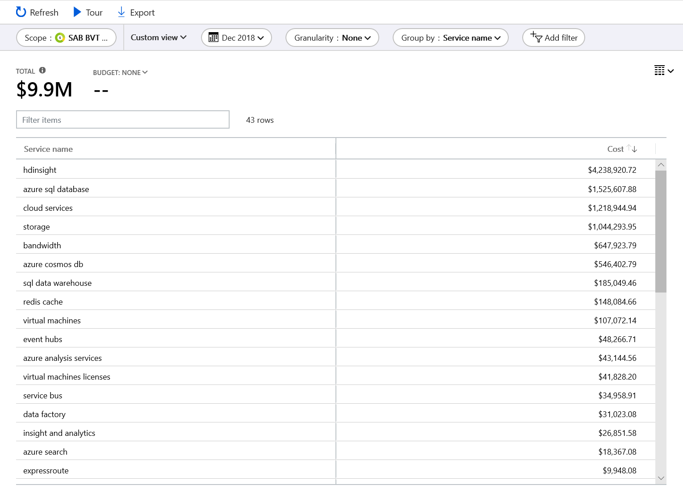
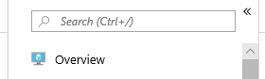
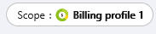
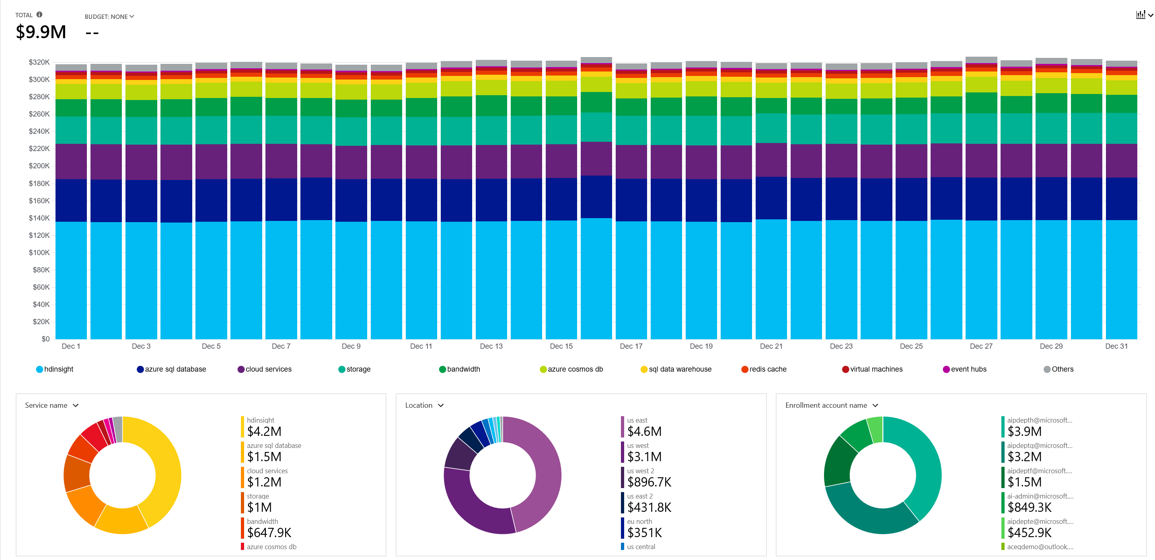
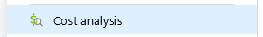
Cost Analysis
Detailed Cost Exploration
Group, filter and view by 14 dimensions
Date Ranges
Daily, accumulated, monthly grain
Saved and scheduled reports
Integrated with Budgets
Enrollment, subscription, management group and resource group scope
Notes:
Ability to slice and dice your data and analyze this on multiple dimensions..

Slide 55
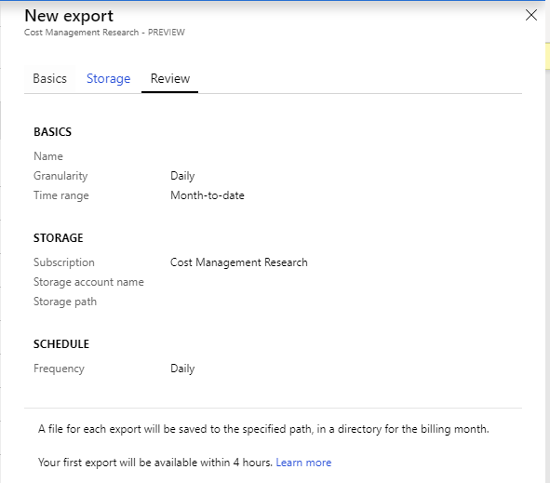
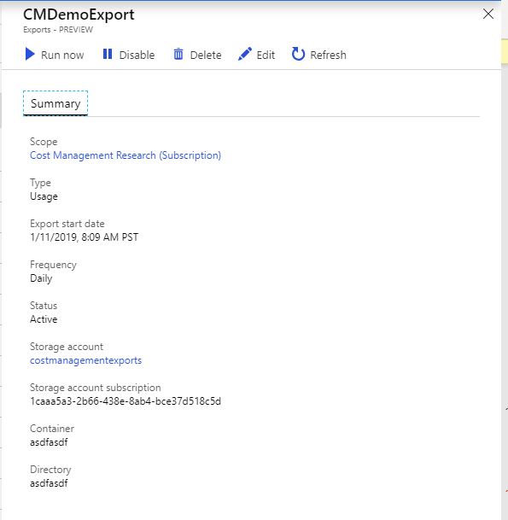
Export Data
Schedule exports for subscription data
Automatically loaded to storage account
Integrated into cost analysis

Slide 56
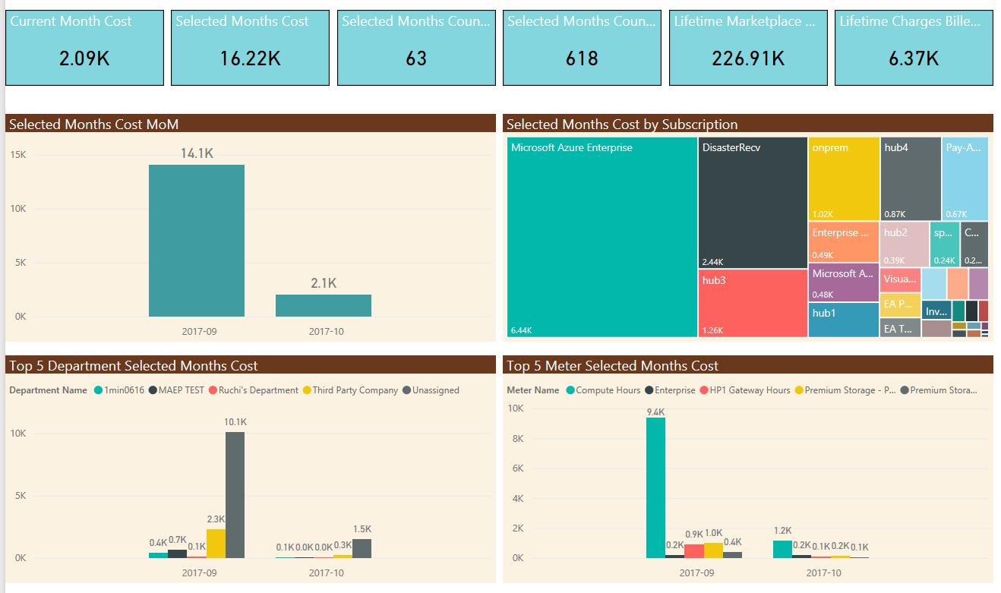
Power BI Content Pack

Slide 57
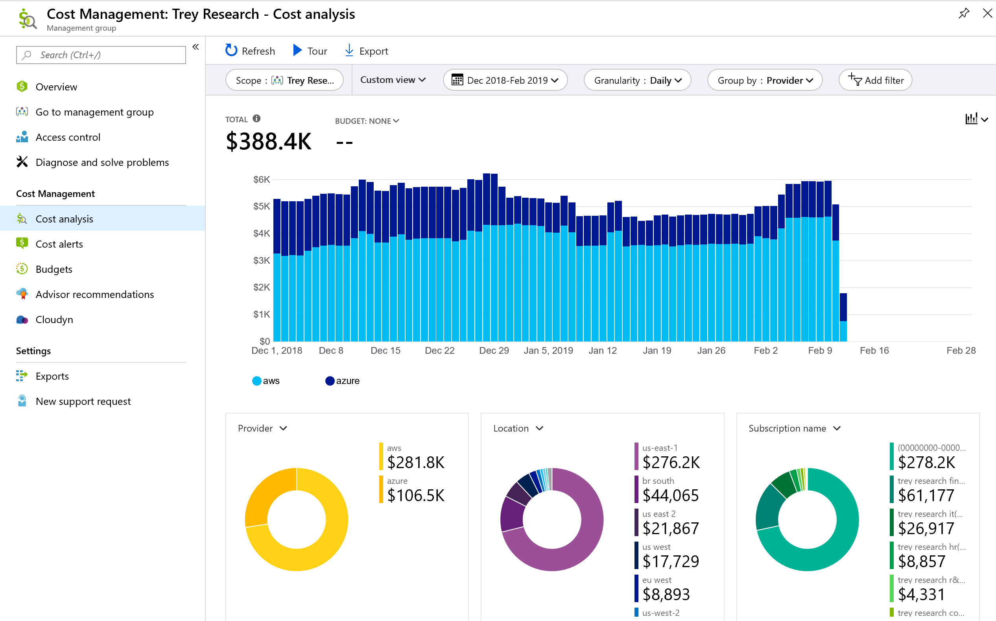
Cost Management support for Cross Cloud - AWS
We also have AWS spend available in ACM
Analyze your costs across Azure & AWS
Currently in private preview

Slide 58
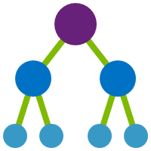


Tags add context for cost analysis
Finance codes - CostCenter tag, etc.
Application context - AppService tag, etc.
Deployment context - Environment tag, etc.
Who is accountable - BusinessOwner tag, etc.
Tags should be enforced by configuration policies
Use Azure Policy to set and track ARM tagging policies
MG, Subscription, RG scopes
Enforce that tags exist
Set default values for tags
Audit if tags are missing
##
###
#
##
TAG = #

Slide 59
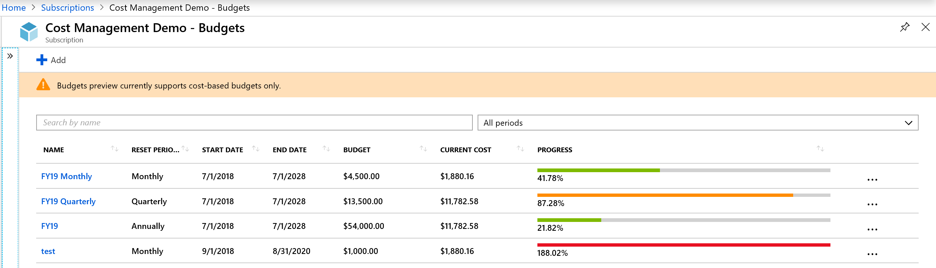
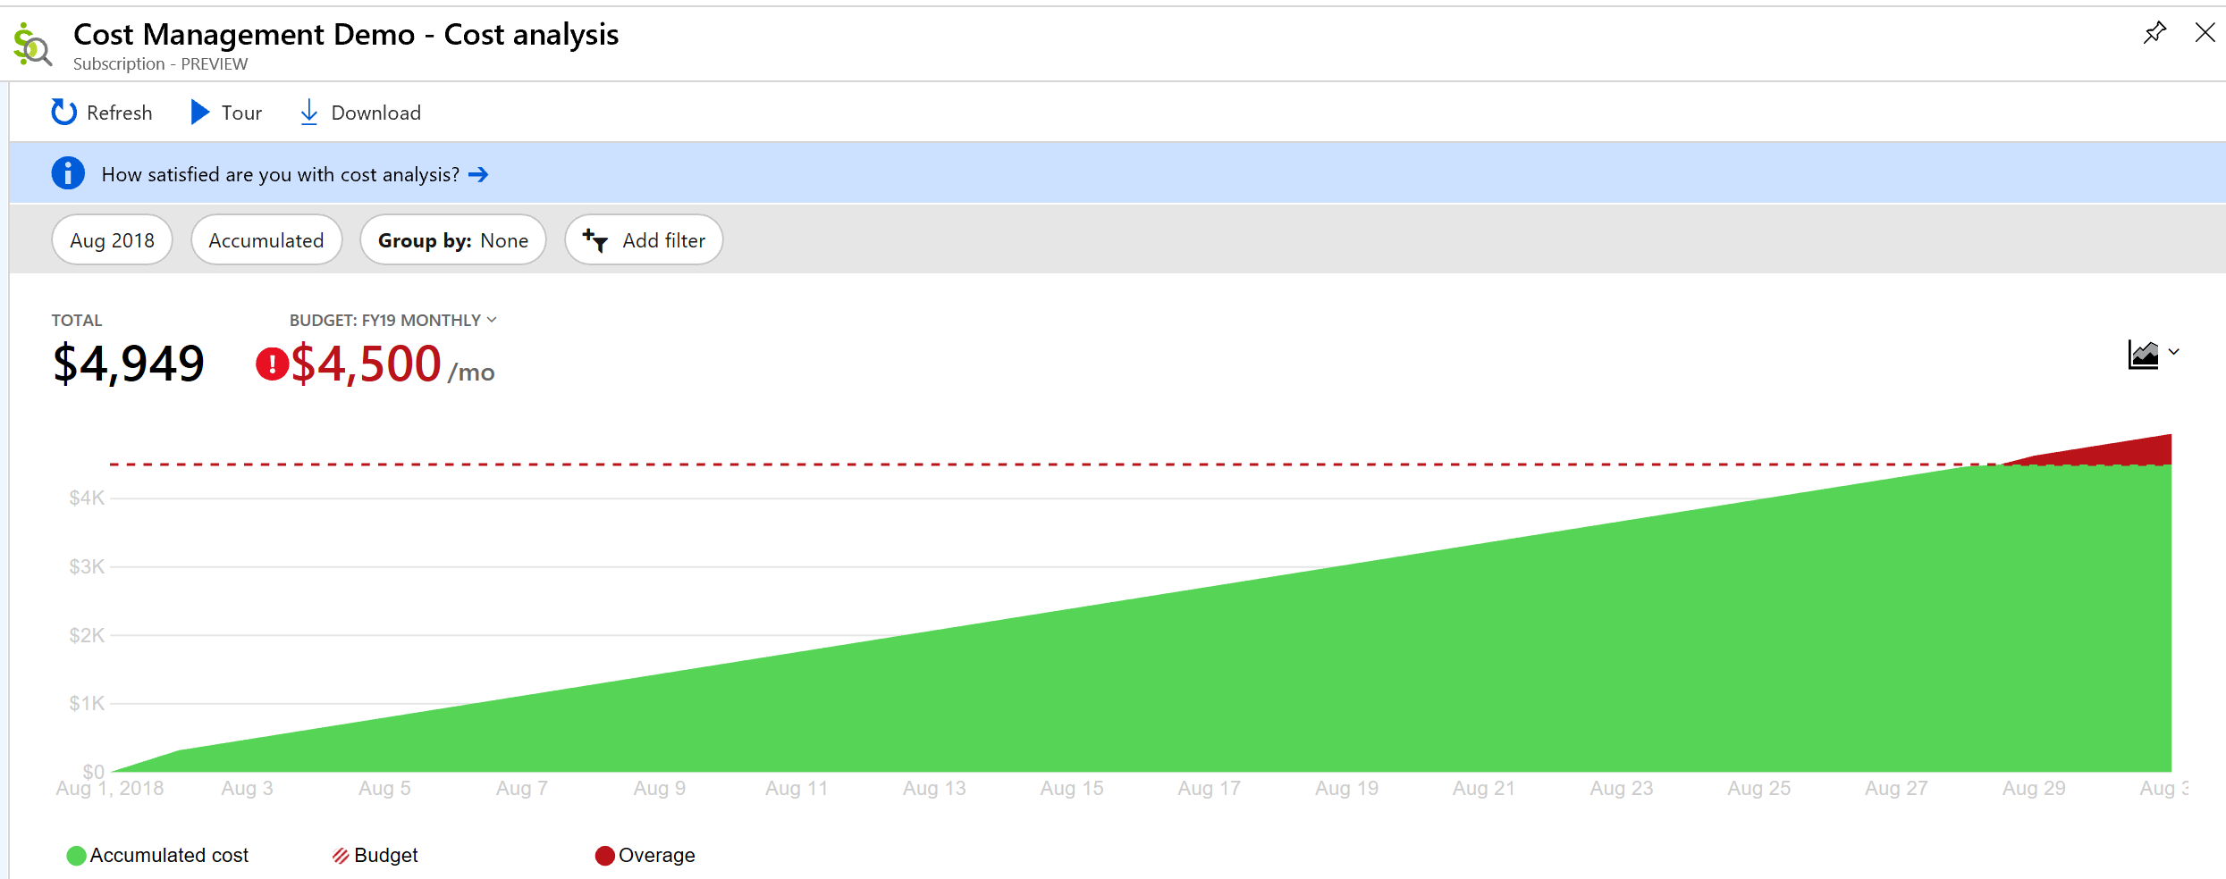
Budgets for monitoring and notifications
Monitor your costs using budgets
Get notified when threshold are met
Automate with Action Groups
Integrated into cost analysis

Slide 60

Cost optimization
The workload will run fine in all three VM sizes
Which will a developer naturally choose?
Which will deliver more success to the business?
Which one will make managers and finance want more things in the cloud?
VM1
VM2
VM3
Workload
Workload
Workload
How do you know when there are opportunities to optimize?

Slide 61
Demo

Slide 62
Cost Management Demo
Create a budget for your subscription (subscription limit is $100)
Create an alert for your subscription that fires when the spend exceeds $15

Slide 63
Agenda
Topic | Time
Logistics | 9:30am
Overview | 9:45am
Enrollment Setup, Management Groups | 10:00 – 10:30am
Challenge | 10:30 – 11:00am
Azure Policy and RBAC | 11:00 – 11:30pm
Challenge | 11:30 – 12:30pm
Lunch | 12:30 – 1:30pm
Blueprints | 1:30 – 2:00pm
Challenge | 2:00 – 2:30pm
Cost Management | 2:30 – 3:00pm
Challenge | 3:00 – 3:30pm
Closing | 3:30 – 4:00pm

Slide 64
Call to action
Ensure that your production resources are well governed
Start using today
Explore features and capabilities
Most services offered at no additional cost
Visit Azure.com/governance
Notes:
Azure has a full set of services to meet all your governance needs
As we come to a close, I would like to you to explore all the new services we have discussed in this session, and ensure that your production resources are well governed

Slide 65
Thank you!

